Slide 2
Dealing with Contractors
Poor response time , little urgency on maintenance requests
Lack of communication
Lack of expertise & staffing
Unfair or dishonest billing practices
Notes:
Poor response time – Contractors simply do not put the same urgency on maintenance requests that the client does
Lack of communication – Contractors frequently do not report their arrival time, departure, or what they did in a timely or coherent fashion
Lack of expertise – Often maintenance companies have only 1 or 2 people that actually have the proper skill level, and they are managing dozens of “apprentice” level technicians that are technically not qualified for the equipment they are servicing
Unfair or dishonest billing practices

Slide 3
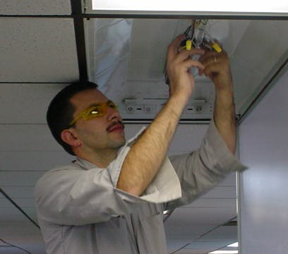
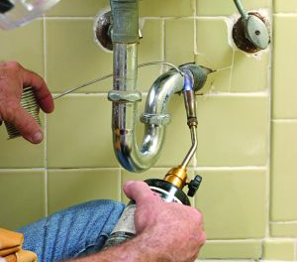
“I have to deal with 15 different contractors to maintain my property.”
One call to eBuilding Service and you are dealing with a professional team capable of meeting ALL of your building maintenance needs.
Notes:
Heating, air conditioning, plumbing, electrical, snow removal, landscaping, doors and locks, tenant finish, new construction, flooring, roofing, and general handyman services.

Slide 4
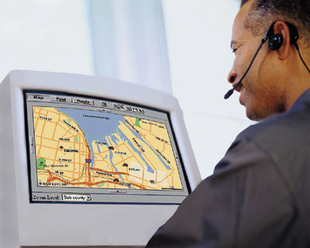
“I never know when they’re going to get there, what they did, or how much it is going to cost me.”
Web access to job status
Technician in-route
Call completed
Invoice submitted
Payment received
24-hour-a-day access to service history
Access to warranty records
Notes:
eBuilding Service’s website provides you 24/7 real-time access to:
Request a quote
Place new service requests
Check the status of an existing job in progress
See billing information in real-time
Look at the service history for your property
Review warranty information

Slide 5
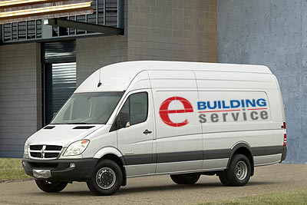
“How do I know that my service company is giving me the most efficient service?”
Real-time GPS tracking
In-van cell-connected laptop computers
Thousands of dollars in parts stock on each van
Lower back-office & fuel costs
Technology-driven
Notes:
With real-time GPS tracking and routing, laptop computers with internet access in our trucks, thousands of dollars in parts stock on our Dodge Sprinter vans, and 24/7 web access for clients, eBuilding Service insures that you never pay for wasted time and you always know where we are and what we’re doing for you. This increased efficiency results in lower back-office costs, lower fuel costs and lower labor costs which we pass on to you. Basically, because we’ve made an investment in our business to have the industry’s best technology, we’re not asking you to pay for inefficiency.

Slide 6
Full Range of Services
Heating & air conditioning
Plumbing & electrical
Snow removal & landscaping
Doors and locks
Tenant finish & new construction
Flooring, roofing, and general maintenance services
Preventative
Maintenance
HVAC
Service
One Call =
LESS
DOWN TIME
Tenant
Finish
Plumbing
& Electrical

Slide 7
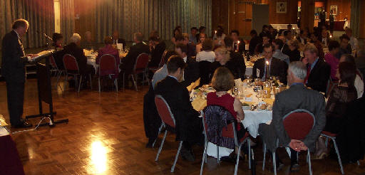
The eBuilding Advantage
Guaranteed 2 hour response to emergencies
No overtime for regular clients
No trip, truck, mileage charges, or misc. charges
Minimum 1 year warranty
Monthly dinner to introduce new clients
Quarterly client appreciation dinners and gifts

Slide 8
Thank you for your time.
Please visit our booth.

